Slide 1


(SQL)
Group Functions
Analytic Functions
Dr. Asif Sohail
University of the Punjab
Department of Information Technology, FCIT

Slide 2
What Are Group Functions?
Group functions operate on sets of rows to give one result per group.
EMP
DEPTNO SAL
--------- ---------
10 2450
10 5000
10 1300
20 800
20 1100
20 3000
20 3000
20 2975
30 1600
30 2850
30 1250
30 950
30 1500
30 1250
“maximum
salary in
the EMP table”
MAX(SAL)
---------
5000
Notes:
Group Functions
Unlike single-row functions, group functions operate on sets of rows to give one result per group. These sets may be the whole table or the table split into groups.

Slide 3
Types of Group Functions
Function | Description
MAX | Returns the largest value
MIN | Returns the smallest value
SUM | Returns the sum of values
AVG | Returns the average of values (ignoring NULL values)
COUNT | Returns the count of NOT NULL values
MEDIAN | Returns the middle value
STDEVE | Returns the standard deviation (ignoring NULL values)
VARIANCE | Returns the variation (ignoring NULL values)
Notes:
Group Functions (continued)
Each of the functions accepts an argument. The following table identifies the options that you can use in the syntax:

Slide 4
Using Group Functions
SELECT [column,] group_function(column)
FROM table
[WHERE condition]
[GROUP BY column]
[ORDER BY column];
Notes:
Guidelines for Using Group Functions
DISTINCT makes the function consider only nonduplicate values; ALL makes it consider every value including duplicates. The default is ALL and therefore does not need to be specified.
The datatypes for the arguments may be CHAR, VARCHAR2, NUMBER, or DATE where expr is listed.
All group functions except COUNT(*) ignore null values. To substitute a value for null values, use the NVL function.
The Oracle Server implicitly sorts the result set in ascending order when using a GROUP BY clause. To override this default ordering, DESC can be used in an ORDER BY clause.
Class Management Note
Stress the use of DISTINCT and group functions ignoring null values. ALL is the default and is very rarely specified.

Slide 5
Using MIN and MAX Functions
You can use MIN and MAX for any datatype.
SQL> SELECT MIN(hiredate), MAX(hiredate)
2 FROM emp;
MIN(HIRED MAX(HIRED
--------- ---------
17-DEC-80 12-JAN-83
Notes:
Group Functions (continued)
You can use MAX and MIN functions for any datatype. The slide example displays the most junior and most senior employee.
The following example displays the employee name that is first and the employee name that is the last in an alphabetized list of all employees.
Note: AVG, SUM, VARIANCE, and STDDEV functions can be used only with numeric datatypes.
SQL> SELECT MIN(ename), MAX(ename)
2 FROM emp;
MIN(ENAME) MAX(ENAME)
---------- ----------
ADAMS WARD

Slide 6
Using AVG and SUM Functions
You can use AVG and SUM for numeric data.
SQL> SELECT AVG(sal), MAX(sal),
2 MIN(sal), SUM(sal)
3 FROM emp
4 WHERE job LIKE 'SALES%';
AVG(SAL) MAX(SAL) MIN(SAL) SUM(SAL)
-------- --------- --------- ---------
1400 1600 1250 5600
Notes:
Group Functions
You can use AVG, SUM, MIN, and MAX functions against columns that can store numeric data. The example on the slide displays the average, highest, lowest, and sum of monthly salaries for all salespeople.

Slide 7
Using the COUNT Function
COUNT(*) returns the number of rows in a table satisfying a given condition (if any).
SQL> SELECT COUNT(*)
2 FROM emp
3 WHERE deptno = 30;
COUNT(*)
---------
6
Notes:
The COUNT Function
The COUNT function has two formats:
COUNT(*)
COUNT(expr)
COUNT(*) returns the number of rows in a table, including duplicate rows and rows containing null values in any of the columns. If a WHERE clause is included in the SELECT statement, COUNT(*) returns the number of rows that satisfies the condition in the WHERE clause.
In contrast, COUNT(expr) returns the number of nonnull rows in the column identified by expr.
The slide example displays the number of employees in department 30.
Class Management Note
Demo: l5count1.sql, l5count2.sql
Purpose: To illustrate using the COUNT(*) and COUNT(expr) functions.

Slide 8
Using the COUNT Function
COUNT(expr) returns the number of rows with non-null values for the expr.
SQL> SELECT COUNT(comm)
2 FROM emp
3 WHERE deptno = 30;
COUNT(COMM)
-----------
4
Notes:
The COUNT Function (continued)
The slide example displays the number of employees in department 30 who can earn a commission. Notice that the result gives the total number of rows to be four because two employees in department 30 cannot earn a commission and contain a null value in the COMM column.
Example
Display the number of departments in the EMP table.
Display the number of distinct departments in the EMP table.
SQL> SELECT COUNT(deptno)
2 FROM emp;
COUNT(DEPTNO)
-------------
14
COUNT(DISTINCT(DEPTNO))
-----------------------
3

Slide 9
Using the COUNT Function
COUNT(DISTINCT expr) returns the number of distinct non-null values of the expr.
SQL> SELECT COUNT(DISTINCT deptno)
2 FROM emp;
COUNT(DISTINCT deptno)
----------------------
4
Notes:
The COUNT Function (continued)
The slide example displays the number of employees in department 30 who can earn a commission. Notice that the result gives the total number of rows to be four because two employees in department 30 cannot earn a commission and contain a null value in the COMM column.
Example
Display the number of departments in the EMP table.
Display the number of distinct departments in the EMP table.
SQL> SELECT COUNT(deptno)
2 FROM emp;
COUNT(DEPTNO)
-------------
14
COUNT(DISTINCT(DEPTNO))
-----------------------
3

Slide 10
Group Functions and Null Values
Group functions ignore null values in the column.
SQL> SELECT AVG(comm)
2 FROM emp;
AVG(COMM)
---------
550
Notes:
Group Functions and Null Values
All group functions except COUNT (*) ignore null values in the column. In the slide example, the average is calculated based only on the rows in the table where a valid value is stored in the COMM column. The average is calculated as total commission being paid to all employees divided by the number of employees receiving commission (4).

Slide 11
Using the NVL Function with Group Functions
The NVL function forces group functions to include null values.
SQL> SELECT AVG(NVL(comm,0))
2 FROM emp;
AVG(NVL(COMM,0))
----------------
157.14286
Notes:
Group Functions and Null Values (continued)
The NVL function forces group functions to include null values. In the slide example, the average is calculated based on all rows in the table regardless of whether null values are stored in the COMM column. The average is calculated as total commission being paid to all employees divided by the total number of employees in the company (14).

Slide 12
Creating Groups of Data
EMP
DEPTNO SAL
--------- ---------
10 2450
10 5000
10 1300
20 800
20 1100
20 3000
20 3000
20 2975
30 1600
30 2850
30 1250
30 950
30 1500
30 1250
2916.6667
“average
salary
in EMP
table
for each
department”
DEPTNO AVG(SAL)
------- ---------
10 2916.6667
20 2175
30 1566.6667
2175
1566.6667
Notes:
Groups of Data
Until now, all group functions have treated the table as one large group of information. At times, you need to divide the table of information into smaller groups. This can be done by using the GROUP BY clause.

Slide 13
Creating Groups of Data:
GROUP BY Clause
SELECT column, group_function(column)
FROM table
[WHERE condition]
[GROUP BY group_by_expression]
[ORDER BY column];
Divide rows in a table into smaller groups by using the GROUP BY clause.
Notes:
The GROUP BY Clause
You can use the GROUP BY clause to divide the rows in a table into groups. You can then use the group functions to return summary information for each group.
In the syntax:
group_by_expression specifies columns whose values determine the basis for
grouping rows
Guidelines
If you include a group function in a SELECT clause, you cannot select individual results as well unless the individual column appears in the GROUP BY clause. You will receive an error message if you fail to include the column list.
Using a WHERE clause, you can preexclude rows before dividing them into groups.
You must include the columns in the GROUP BY clause.
You cannot use the column alias in the GROUP BY clause.
By default, rows are sorted by ascending order of the columns included in the GROUP BY list. You can override this by using the ORDER BY clause.

Slide 14
Using the GROUP BY Clause
All columns in the SELECT list that are not in group functions must be in the GROUP BY clause.
SQL> SELECT deptno, AVG(sal)
2 FROM emp
3 GROUP BY deptno;
DEPTNO AVG(SAL)
--------- ---------
10 2916.6667
20 2175
30 1566.6667
Notes:
The GROUP BY Clause (continued)
When using the GROUP BY clause, make sure that all columns in the SELECT list that are not in the group functions are included in the GROUP BY clause. The example on the slide displays the department number and the average salary for each department. Here is how this SELECT statement, containing a GROUP BY clause, is evaluated:
The SELECT clause specifies the columns to be retrieved:
Department number column in the EMP table
The average of all the salaries in the group you specified in the GROUP BY clause
The FROM clause specifies the tables that the database must access: the EMP table.
The WHERE clause specifies the rows to be retrieved. Since there is no WHERE clause, by default all rows are retrieved.
The GROUP BY clause specifies how the rows should be grouped. The rows are being grouped by department number, so the AVG function that is being applied to the salary column will calculate the average salary for each department.

Slide 15
Using the GROUP BY Clause
The GROUP BY column does not have to be in the SELECT list.
SQL> SELECT AVG(sal)
2 FROM emp
3 GROUP BY deptno;
AVG(SAL)
---------
2916.6667
2175
1566.6667
Notes:
The GROUP BY Clause (continued)
The GROUP BY column does not have to be in the SELECT clause. For example, the SELECT statement on the slide displays the average salaries for each department without displaying the respective department numbers. Without the department numbers, however, the results do not look meaningful.
You can use the group function in the ORDER BY clause.
Class Management Note
Demonstrate the query with and without the DEPTNO in the SELECT statement.
DEPTNO AVG(SAL)
---------- ------------
30 1566.6667
20 2175
10 2916.6667

Slide 16
Grouping by More
Than One Column
EMP
DEPTNO JOB SAL
--------- --------- ---------
10 MANAGER 2450
10 PRESIDENT 5000
10 CLERK 1300
20 CLERK 800
20 CLERK 1100
20 ANALYST 3000
20 ANALYST 3000
20 MANAGER 2975
30 SALESMAN 1600
30 MANAGER 2850
30 SALESMAN 1250
30 CLERK 950
30 SALESMAN 1500
30 SALESMAN 1250
DEPTNO
--------
10
10
10
20
20
20
30
30
30
JOB SUM(SAL)
--------- ---------
CLERK 1300
MANAGER 2450
PRESIDENT 5000
ANALYST 6000
CLERK 1900
MANAGER 2975
CLERK 950
MANAGER 2850
SALESMAN 5600
“sum salaries in
the EMP table
for each job,
grouped by
department”
Notes:
Groups Within Groups
Sometimes there is a need to see results for groups within groups. The slide shows a report that displays the total salary being paid to each job title, within each department.
The EMP table is grouped first by department number, and within that grouping, it is grouped by job title. For example, the two clerks in department 20 are grouped together and a single result (total salary) is produced for all salespeople within the group.
Class Management Note
Demo: l5order1.sql,l5order2.sql
Purpose: To illustrate ordering columns that are grouped by DEPTNO first and ordering columns that are grouped by JOB first.

Slide 17
Using the GROUP BY Clause on Multiple Columns
SQL> SELECT deptno, job, sum(sal)
2 FROM emp
3 GROUP BY deptno, job;
DEPTNO JOB SUM(SAL)
--------- --------- ---------
10 CLERK 1300
10 MANAGER 2450
10 PRESIDENT 5000
20 ANALYST 6000
20 CLERK 1900
...
9 rows selected.
Notes:
Groups Within Groups (continued)
You can return summary results for groups and subgroups by listing more than one GROUP BY column. You can determine the default sort order of the results by the order of the columns in the GROUP BY clause. Here is how the SELECT statement on the slide, containing a GROUP BY clause, is evaluated:
The SELECT clause specifies the column to be retrieved:
Department number in the EMP table
Job title in the EMP table
The sum of all the salaries in the group that you specified in the
GROUP BY clause
The FROM clause specifies the tables that the database must access: the EMP table.
The GROUP BY clause specifies how you must group the rows:
First, the rows are grouped by department number.
Second, within the department number groups, the rows are grouped by job title.
So the SUM function is being applied to the salary column for all job titles within each department number group.

Slide 18
Illegal Queries
Using Group Functions
Any column or expression in the SELECT list that is not an aggregate function must be in the GROUP BY clause.
SQL> SELECT deptno, COUNT(ename)
2 FROM emp;
Column missing in the GROUP BY clause
SELECT deptno, COUNT(ename)
*
ERROR at line 1:
ORA-00937: not a single-group group function
Notes:
Illegal Queries Using Group Functions
Whenever you use a mixture of individual items (DEPTNO) and group functions (COUNT) in the same SELECT statement, you must include a GROUP BY clause that specifies the individual items (in this case, DEPTNO). If the GROUP BY clause is missing, then the error message “not a single-group group function” appears and an asterisk (*) points to the offending column. You can correct the error on the slide by adding the GROUP BY clause.
Any column or expression in the SELECT list that is not an aggregate function must be in the GROUP BY clause.
Class Management Note
Demo: l5error.sql
Purpose: To illustrate executing a SELECT statement with no GROUP BY clause.
SQL> SELECT deptno, COUNT(ename)
2 FROM emp
3 GROUP BY deptno;
DEPTNO COUNT(ENAME)
---------- ------------
10 3
20 5
30 6

Slide 19
Illegal Queries
Using Group Functions
  You cannot use the WHERE clause to restrict groups.
  You use the HAVING clause to restrict groups.
SQL> SELECT deptno, AVG(sal)
2 FROM emp
3 WHERE AVG(sal) > 2000
4 GROUP BY deptno;
Cannot use the WHERE clause
to restrict groups
WHERE AVG(sal) > 2000
*
ERROR at line 3:
ORA-00934: group function is not allowed here
Notes:
Illegal Queries Using Group Functions (continued)
The WHERE clause cannot be used to restrict groups. The SELECT statement on the slide results in an error because it uses the WHERE clause to restrict the display of average salaries of those departments that have an average salary greater than $2000.
You can correct the slide error by using the HAVING clause to restrict groups.
SQL> SELECT deptno, AVG(sal)
2 FROM emp
3 GROUP BY deptno
4 HAVING AVG(sal) > 2000;

Slide 20
Excluding Group Results
EMP
DEPTNO SAL
--------- ---------
10 2450
10 5000
10 1300
20 800
20 1100
20 3000
20 3000
20 2975
30 1600
30 2850
30 1250
30 950
30 1500
30 1250
5000
“maximum
salary
per department
greater than
$2900”
DEPTNO MAX(SAL)
--------- ---------
10 5000
20 3000
3000
2850
Notes:
Restricting Group Results
In the same way that you use the WHERE clause to restrict the rows that you select, you use the HAVING clause to restrict groups. To find the maximum salary of each department, but show only the departments that have a maximum salary of more than $2900, you need to do the following:
Find the average salary for each department by grouping by department number.
Restrict the groups to those departments with a maximum salary greater than $2900.

Slide 21
Excluding Group Results: HAVING Clause
Use the HAVING clause to restrict groups
    Rows are grouped.
    The group function is applied.
    Groups matching the HAVING clause are displayed.
SELECT column, group_function
FROM table
[WHERE condition]
[GROUP BY group_by_expression]
[HAVING group_condition]
[ORDER BY column];
Notes:
The HAVING Clause
You use the HAVING clause to specify which groups are to be displayed. Therefore, you further restrict the groups on the basis of aggregate information.
In the syntax:
group_condition restricts the groups of rows returned to those groups for which
the specified condition is TRUE
The Oracle Server performs the following steps when you use the HAVING clause:
Rows are grouped.
The group function is applied to the group.
The groups that match the criteria in the HAVING clause are displayed.
The HAVING clause can precede the GROUP BY clause, but it is recommended that you place the GROUP BY clause first because it is more logical. Groups are formed and group functions are calculated before the HAVING clause is applied to the groups in the SELECT list.

Slide 22
Using the HAVING Clause
SQL> SELECT deptno, max(sal)
2 FROM emp
3 GROUP BY deptno
4 HAVING max(sal)>2900;
DEPTNO MAX(SAL)
--------- ---------
10 5000
20 3000
Notes:
The HAVING Clause (continued)
The slide example displays department numbers and maximum salary for those departments whose maximum salary is greater than $2900.
You can use the GROUP BY clause without using a group function in the SELECT list.
If you restrict rows based on the result of a group function, you must have a GROUP BY clause as well as the HAVING clause.
The following example displays the department numbers and average salary for those departments whose maximum salary is greater than $2900:
SQL> SELECT deptno, AVG(sal)
2 FROM emp
3 GROUP BY deptno
4 HAVING MAX(sal) > 2900;

Slide 23
Using the HAVING Clause
SQL> SELECT job, SUM(sal) PAYROLL
2 FROM emp
3 WHERE job NOT LIKE 'SALES%'
4 GROUP BY job
5 HAVING SUM(sal)>5000
6 ORDER BY SUM(sal);
JOB PAYROLL
--------- ---------
ANALYST 6000
MANAGER 8275
Notes:
The HAVING Clause (continued)
The slide example displays the job title and total monthly salary for each job title with a total payroll exceeding $5000. The example excludes salespeople and sorts the list by the total monthly salary.
Class Management Note
Demo: l5job1.sql, l5job2.sql
Purpose: To illustrate using a WHERE clause to restrict rows by JOB and using a HAVING clause to restrict groups by SUM(SAL).

Slide 24
Nesting Group Functions
Display the maximum average salary.
SQL> SELECT max(avg(sal))
2 FROM emp
3 GROUP BY deptno;
MAX(AVG(SAL))
-------------
2916.6667
Notes:
Nesting Group Functions
Group functions can be nested to a depth of two. The slide example displays the maximum average salary.

Slide 25
Extended Group by Clauses
ROLLUP extends the GROUP BY clause to return a row containing a subtotal for each group of rows, plus a row containing a grand total for all the groups.
SELECT deptno, SUM(sal)
FROM emp
GROUP BY deptno;
SELECT deptno, SUM(sal)
FROM emp
GROUP BY ROLLUP(deptno);
DEPTNO | SUM(SAL)
30 | 9400
20 | 10875
10 | 8750
DEPTNO | SUM(SAL)
10 | 8750
20 | 10875
30 | 9400
- | 29025
Notes:
Nesting Group Functions
Group functions can be nested to a depth of two. The slide example displays the maximum average salary.

Slide 26
Extended Group by Clauses
Multiple columns can be passed to ROLLUP.
The order of ROWS is significant.
SELECT deptno,job,SUM(sal)
FROM emp
GROUP BY ROLLUP(deptno,job)
SELECT deptno,job,SUM(sal)
FROM emp
GROUP BY ROLLUP(job,deptno);
DEPTNO | JOB | SUM(SAL)
10 | CLERK | 1300
10 | MANAGER | 2450
10 | PRESIDENT | 5000
10 | - | 8750
20 | CLERK | 1900
20 | ANALYST | 6000
20 | MANAGER | 2975
20 | - | 10875
30 | CLERK | 950
30 | MANAGER | 2850
30 | SALESMAN | 5600
30 | - | 9400
- | - | 29025
DEPTNO | JOB | SUM(SAL)
10 | CLERK | 1300
20 | CLERK | 1900
30 | CLERK | 950
- | CLERK | 4150
20 | ANALYST | 6000
- | ANALYST | 6000
10 | MANAGER | 2450
20 | MANAGER | 2975
30 | MANAGER | 2850
- | MANAGER | 8275
- | - | -
- | - | 29025
Notes:
Nesting Group Functions
Group functions can be nested to a depth of two. The slide example displays the maximum average salary.

Slide 27
Extended Group by Clauses
CUBE extends the GROUP BY clause to return rows containing a subtotal for all combinations of the values in the columns, plus a row containing the grand total.
Unlike ROLLUP, the order of columns in a CUBE is not significant.
Notes:
Nesting Group Functions
Group functions can be nested to a depth of two. The slide example displays the maximum average salary.

Slide 28
SELECT deptno, job,SUM(sal)
FROM emp
GROUP BY CUBE(deptno,job);
SELECT deptno,job,SUM(sal)
FROM emp
GROUP BY ROLLUP(deptno,job)
DEPTNO | JOB | SUM(SAL)
- | - | 29025
10 | - | 8750
20 | - | 10875
30 | - | 9400
- | CLERK | 4150
10 | CLERK | 1300
20 | CLERK | 1900
30 | CLERK | 950
- | ANALYST | 6000
20 | ANALYST | 6000
- | MANAGER | 8275
10 | MANAGER | 2450
20 | MANAGER | 2975
30 | MANAGER | 2850
- | SALESMAN | 5600
30 | SALESMAN | 5600
- | PRESIDENT | 5000
10 | PRESIDENT | 5000
DEPTNO | JOB | SUM(SAL)
10 | CLERK | 1300
10 | MANAGER | 2450
10 | PRESIDENT | 5000
10 | - | 8750
20 | CLERK | 1900
20 | ANALYST | 6000
20 | MANAGER | 2975
20 | - | 10875
30 | CLERK | 950
30 | MANAGER | 2850
30 | SALESMAN | 5600
30 | - | 9400
- | - | 29025
Notes:
Nesting Group Functions
Group functions can be nested to a depth of two. The slide example displays the maximum average salary.

Slide 29
Extended Group by Clauses
GROUPING SETS is used to get the sub-total rows only.
SELECT NVL(to_char(deptno),'All Depts.') "Deptno", NVL(job,'All Jobs') "Job",SUM(sal) FROM emp GROUP BY GROUPING SETS (deptno,job)
Deptno | Job | SUM(SAL)
All Depts. | CLERK | 4150
All Depts. | SALESMAN | 5600
All Depts. | PRESIDENT | 5000
All Depts. | MANAGER | 8275
All Depts. | ANALYST | 6000
30 | All Jobs | 9400
20 | All Jobs | 10875
10 | All Jobs | 8750
Notes:
Nesting Group Functions
Group functions can be nested to a depth of two. The slide example displays the maximum average salary.

Slide 30
List Aggregate
LISTAGG() function transforms data from multiple rows into a single list of values.
SELECT job, LISTAGG(ename,',') WITHIN GROUP(ORDER BY ename) AS employees FROM emp GROUP BY job ORDER BY job;
JOB | EMPLOYEES
ANALYST | FORD,SCOTT
CLERK | ADAMS,JAMES,MILLER,SMITH
MANAGER | BLAKE,CLARK,JONES
PRESIDENT | KING
SALESMAN | ALLEN,MARTIN,TURNER,WARD
Notes:
Nesting Group Functions
Group functions can be nested to a depth of two. The slide example displays the maximum average salary.

Slide 31
Summary
SELECT column, group_function(column)
FROM table
[WHERE condition]
[GROUP BY group_by_expression]
[HAVING group_condition]
[ORDER BY column];
Order of evaluation of the clauses:
  WHERE clause
  GROUP BY clause
  HAVING clause
Notes:
Summary
Seven group functions are available in SQL:
AVG
COUNT
MAX
MIN
SUM
STDDEV
VARIANCE
You can create subgroups by using the GROUP BY clause. Groups can be excluded using the HAVING clause.
Place the HAVING and GROUP BY clauses after the WHERE clause in a statement. Place the ORDER BY clause last.
The Oracle Server evaluates the clauses in the following order:
If the statement contains a WHERE clause, the server establishes the candidate rows.
The server identifies the groups specified in the GROUP BY clause.
The HAVING clause further restricts result groups that do not meet the group criteria in the HAVING clause.

Slide 32
Analytic Functions
analytic functions that enable you to perform complex calculations, such as finding the top-selling product type for each month, the top salespersons, and so on.
The analytic functions are organized into the following categories:
  Window Functions
  Ranking Functions
Notes:
Nesting Group Functions
Group functions can be nested to a depth of two. The slide example displays the maximum average salary.

Slide 33
Window Functions
A window function performs an aggregate-like operation within a certain window or within a specified set of query rows.
Whereas an aggregate operation groups query rows into a single result row, a window function produces a result for each query row.
SELECT col_list, window_function(col) OVER([PARTITION BY col ORDER by col]) ORDER BY clause] FROM table; window_function: Any aggregate function
Notes:
Nesting Group Functions
Group functions can be nested to a depth of two. The slide example displays the maximum average salary.

Slide 34
Window Functions
SELECT ename,job, sal, SUM(sal) OVER() "Total Sal" SUM(sal) OVER(PARTITION BY job) "Job Sal" FROM emp;
ENAME | JOB | SAL | Total Sal | Job Sal
FORD | ANALYST | 3000 | 29025 | 6000
SCOTT | ANALYST | 3000 | 29025 | 6000
SMITH | CLERK | 800 | 29025 | 4150
ADAMS | CLERK | 1100 | 29025 | 4150
MILLER | CLERK | 1300 | 29025 | 4150
BLAKE | MANAGER | 2850 | 29025 | 8275
Notes:
Nesting Group Functions
Group functions can be nested to a depth of two. The slide example displays the maximum average salary.

Slide 35
Ranking Functions
RANK(): It assigns rank to all the rows within every partition. Rank is assigned such that rank 1 given to the first row and rows having same value are assigned same rank. For the next rank after two same rank values, one rank value will be skipped. For instance, if two rows share­ rank 1, the next row gets rank 3, not 2.
DENSE_RANK(): Same as Rank() except that no rank is skipped.
ROW_NUMBER(): It assigns a unique row number (starting with 1) to all the rows of a partition. The numbering resets with each partition.
ORDER BY clause is compulsorily while using rank window functions.
Notes:
Nesting Group Functions
Group functions can be nested to a depth of two. The slide example displays the maximum average salary.

Slide 36
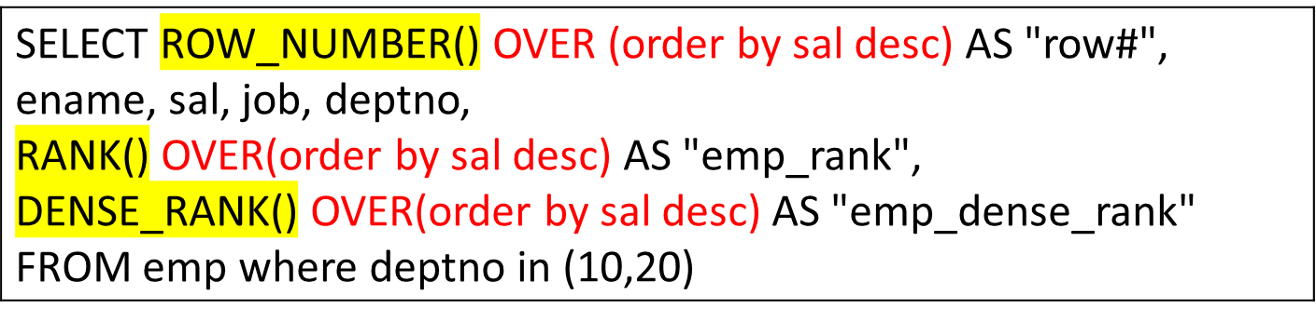
Ranking Window Functions
row# | ENAME | SAL | JOB | DEPTNO | emp_rank | emp_dense_rank
1 | KING | 5000 | PRESIDENT | 10 | 1 | 1
2 | SCOTT | 3000 | ANALYST | 20 | 2 | 2
3 | FORD | 3000 | ANALYST | 20 | 2 | 2
4 | JONES | 2975 | MANAGER | 20 | 4 | 3
5 | CLARK | 2450 | MANAGER | 10 | 5 | 4
6 | MILLER | 1300 | CLERK | 10 | 6 | 5
7 | ADAMS | 1100 | CLERK | 20 | 7 | 6
8 | SMITH | 800 | CLERK | 20 | 8 | 7

Slide 37
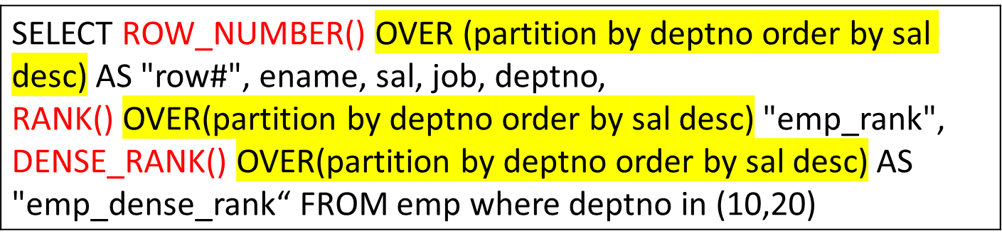
Ranking Window Functions
row# | ENAME | SAL | JOB | DEPTNO | emp_rank | emp_dense_rank
1 | KING | 5000 | PRESIDENT | 10 | 1 | 1
2 | CLARK | 2450 | MANAGER | 10 | 2 | 2
3 | MILLER | 1300 | CLERK | 10 | 3 | 3
1 | SCOTT | 3000 | ANALYST | 20 | 1 | 1
2 | FORD | 3000 | ANALYST | 20 | 1 | 2
3 | JONES | 2975 | MANAGER | 20 | 3 | 3
4 | ADAMS | 1100 | CLERK | 20 | 4 | 4
5 | SMITH | 800 | CLERK | 20 | 5 | 5

Slide 38
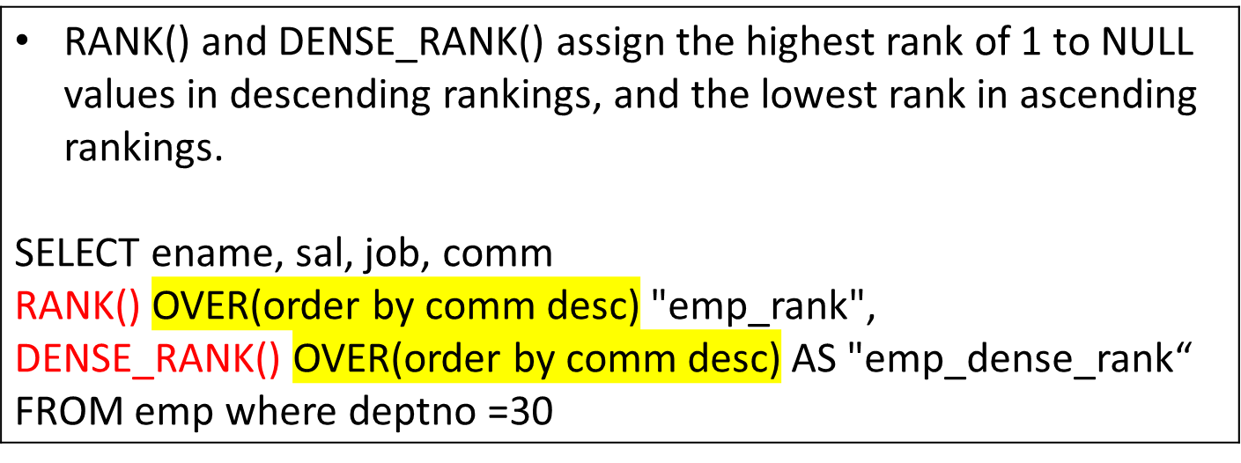
Ranking – NULL values
ENAME | SAL | JOB | COMM | emp_rank | emp_dense_rank
BLAKE | 2850 | MANAGER | - | 1 | 1
JAMES | 950 | CLERK | - | 1 | 1
MARTIN | 1250 | SALESMAN | 1400 | 3 | 2
WARD | 1250 | SALESMAN | 500 | 4 | 3
ALLEN | 1600 | SALESMAN | 300 | 5 | 4
TURNER | 1500 | SALESMAN | 0 | 6 | 5

Slide 39
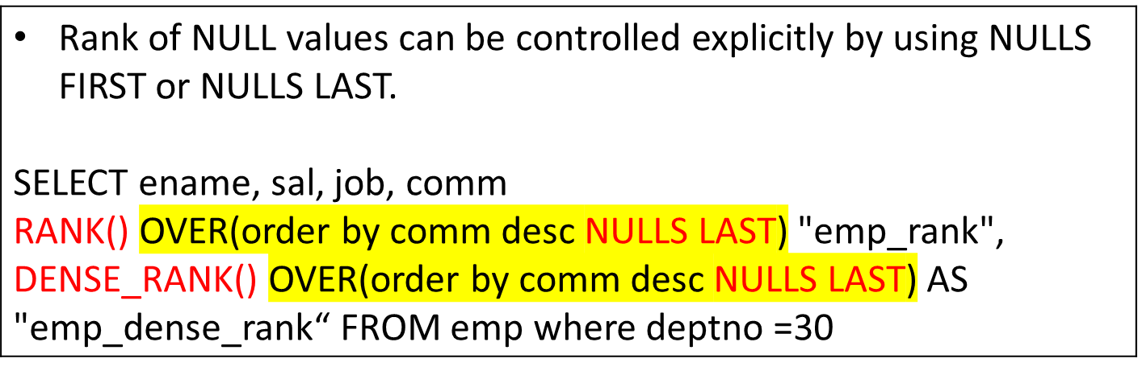
Ranking – NULL values
ENAME | SAL | JOB | COMM | emp_rank | emp_dense_rank
MARTIN | 1250 | SALESMAN | 1400 | 1 | 1
WARD | 1250 | SALESMAN | 500 | 2 | 2
ALLEN | 1600 | SALESMAN | 300 | 3 | 3
TURNER | 1500 | SALESMAN | 0 | 4 | 4
JAMES | 950 | CLERK | - | 5 | 5
BLAKE | 2850 | MANAGER | - | 5 | 5

Slide 40
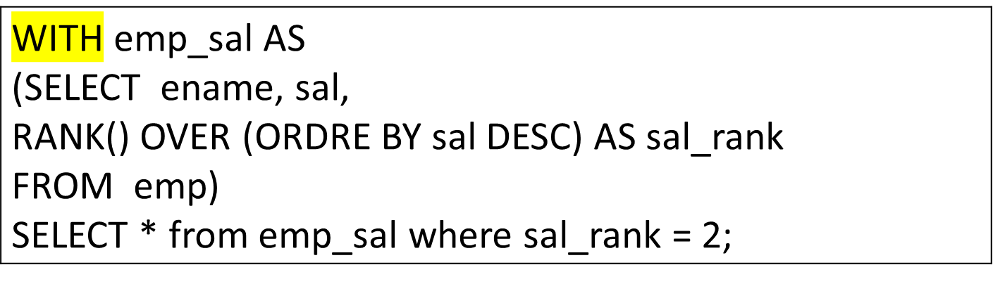
Ranking – Nth Rank
ENAME | SAL | SAL_RANK
SCOTT | 3000 | 2
FORD | 3000 | 2

Slide 41
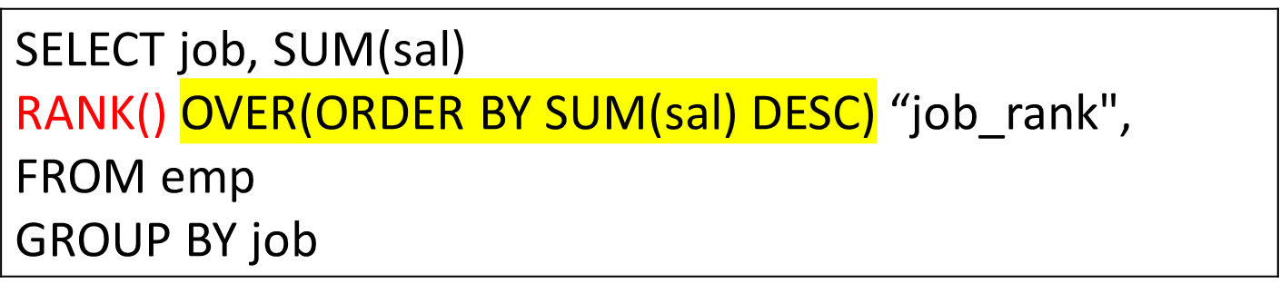
Ranking with GROUP functions
JOB | SUM(SAL) | job_rank
MANAGER | 8275 | 1
ANALYST | 6000 | 2
SALESMAN | 5600 | 3
PRESIDENT | 5000 | 4
CLERK | 4150 | 5

Slide 42
Thank you for your attention.
Dr. Asif Sohail
Assistant Professor
Department of Information Technology,
Faculty of Computing and Information Technology (FCIT)
University of the Punjab, Lahore, Pakistan
Tel: +92-(0)42-111-923-923 Ext. 154
E-mail: asif@pucit.edu.pk

